Slide 1
Clean air analytics and comparison of big data technologies
Arjun Chaudhary
727553
Supervisor: Richard Sinnott

Slide 2
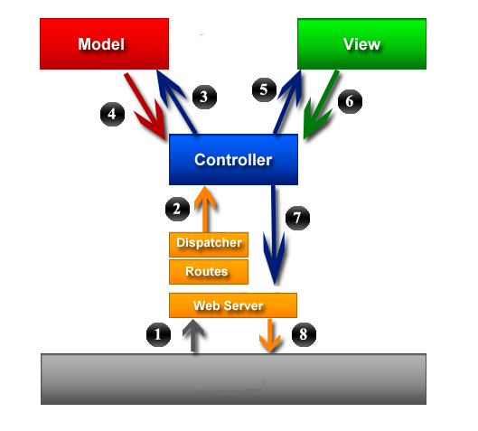

Slide 3
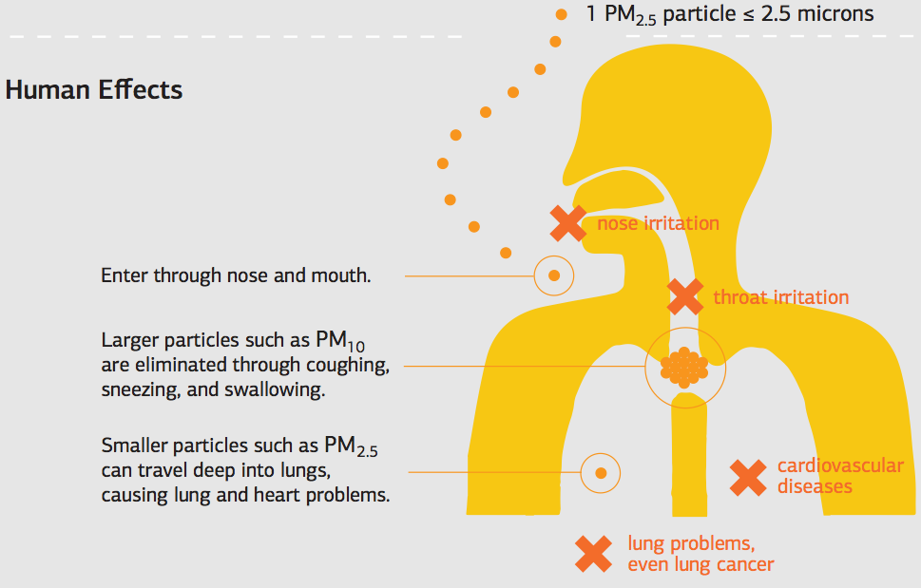
Background
37% of women at PeterMac that have lung cancer have never smoked and has no history of cancer in the family. Why? Air pollution…???
Notes:
http://www.lifestinymiracles.com/2014/03/hope-this-clears-the-air-navigating-the-confusing-world-of-air-purifiers/
http://www.eng.unimelb.edu.au/case-studies/big-data-tools
http://www.oecd.org/env/the-cost-of-air-pollution-9789264210448-en.htm
http://www.cancer.org/cancer/news/features/why-lung-cancer-strikes-nonsmokers
The Peter MacCallum Cancer Centre, also known as the Peter MacCallum Cancer Institute and commonly abbreviated as the Peter Mac, is an Australian oncology research institute.
Air pollution. It’s long been known that both indoor and outdoor air pollution contribute to lung cancer. In 2013, the World Health Organization (WHO) classified outdoor air pollution as a cancer causing agent (carcinogen). According to Elizabeth Ward, PhD, American Cancer Society National Vice President, Intramural Research, the risk of lung cancer associated with air pollution is lower in the US than in many other countries because of policies that have helped to lower the levels of exposure.
The IARC has previously classified many components of outdoor air pollution as carcinogens, including diesel engine exhaust, solvents, metals, and dust. But this is the first time it has classified outdoor air pollution – as a whole – as a carcinogen. It also classified another major component of outdoor air pollution – called particulate matter – as a carcinogen on its own.
http://www.oecd.org/env/the-cost-of-air-pollution-9789264210448-en.htm
Cost of death from outdoor air pollution => OECD (2005 to 2010) => 2,981 5821 USD million dollars.

Slide 4
Data Sources
Many places for pollution data – some hard to access (Real-time VicRoads SCATS data not directly accessible)
Can use Twitter as model for traffic; citizen science airbeams
Twitter
Around 4 million tweets, tweeted from 2014-2016.
Historical Data
PSMA data from AURIN.
Aircasting APP
Particulate Matter.
Humidity.
Sound Level.
Temperature.
About 1 million tweets made in 2014.
City Of Melbourne: Pedestrian Counting System.
Aircast APP recordings.
SCATS data.
7 GB of DATA
Notes:
EPA Australia.
Citizen Scientists from around the world to take measurements, contribute to the crowdmap, and make change! We live in a world where expert knowledge is no longer the exclusive province of experts, where citizens, armed with affordable and accessible instruments, can make unprecedented contributions to scientific understanding.

Slide 5
System Architecture
Needs a big data processing platform

Slide 6
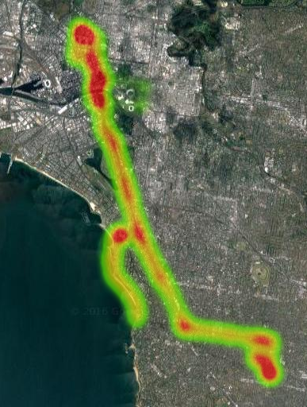
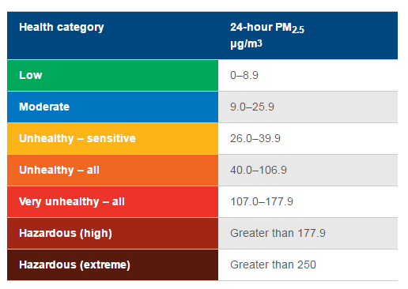
Analytics and Visualisation

Slide 7
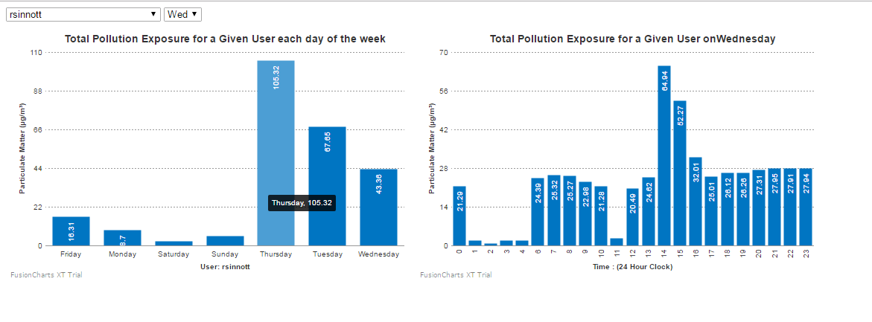
Analytics

Slide 8
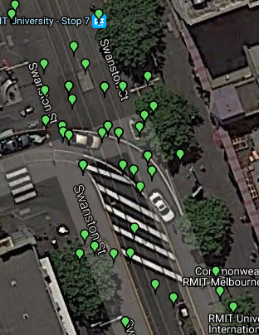
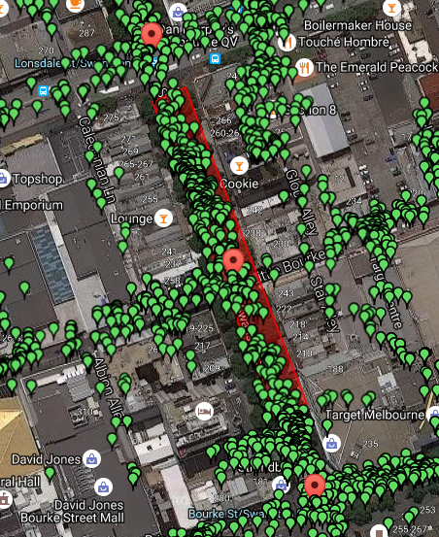
Higher-resolution Visualisation

Slide 9
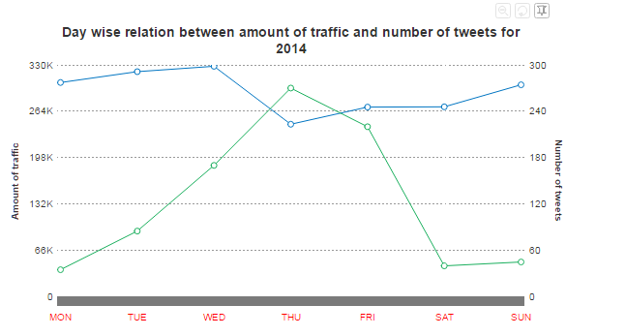
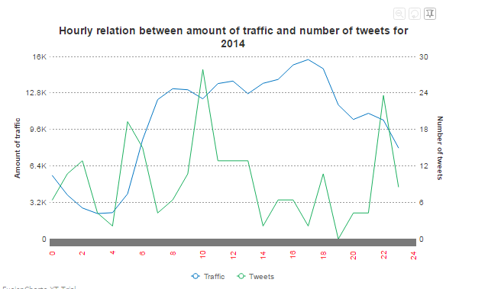

Slide 10
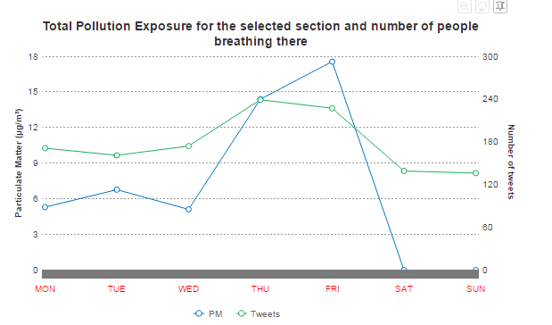
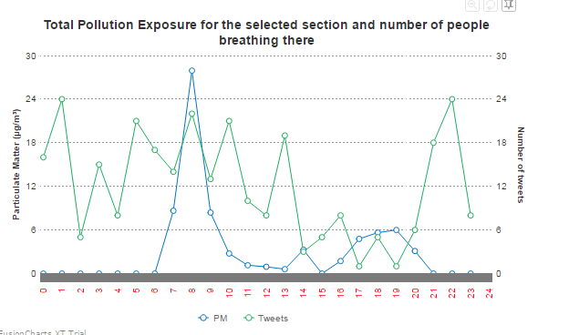

Slide 11
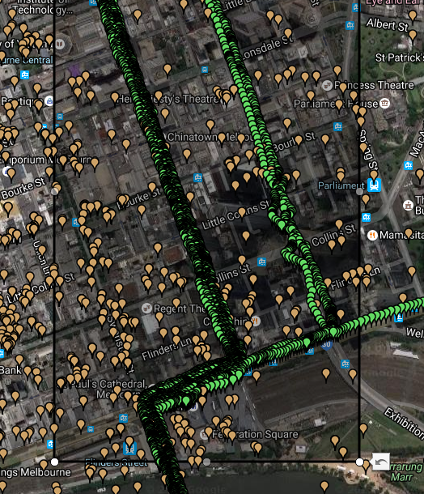
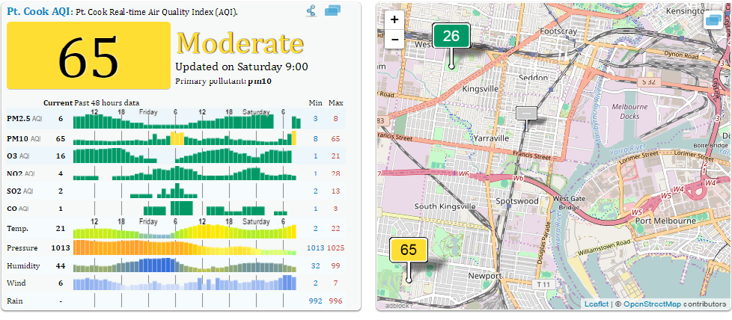
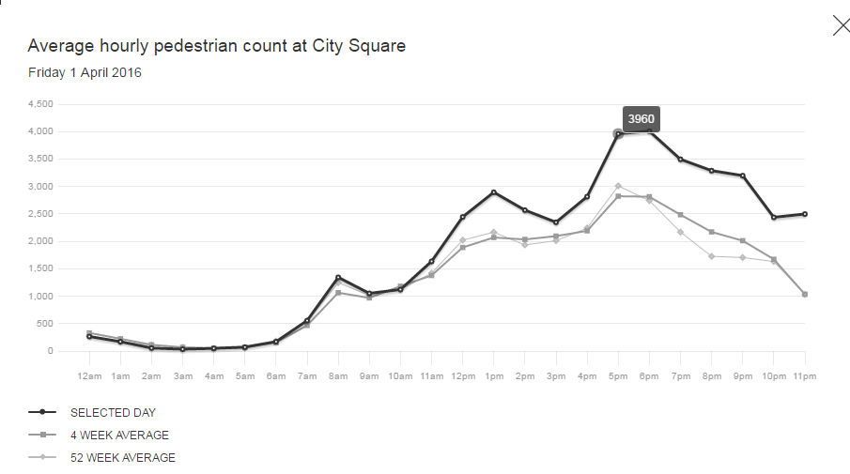
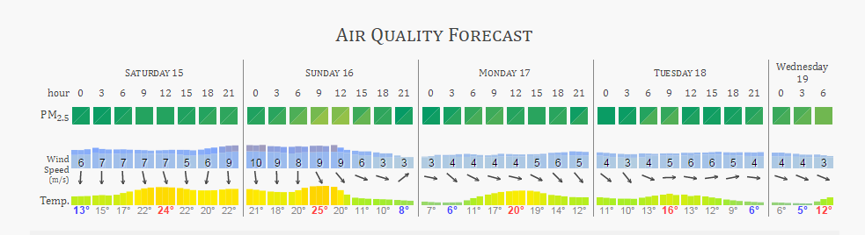
It goes on...

Slide 12
MySQL Cross Join VS SPARK
val x = sc.parallelize(RDD_SCAT) val y = sc.parallelize(RDD_TWEET) x.cartesian(y).collect
8 times faster (1 node, 4 core, 16 GB RAM)
For CBD, 10 million rows.
Notes:
ERROR 1114 (HY000): The table 'roadAndTweetsCoordinates' is full.
Spark significantly faster processing than Hadoop MapReduce
Accumulo / GeoMesa makes storing of large spatio-temporal datasets highly efficient
visualisation of data handled by GeoServer
real-time aggregation and area selection possible

Slide 13
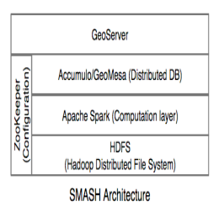
Comparing with BIG DATA TECHNOLOGIES
Notes:
GeoMesa is a cloud-based spatio-temporal database built on top of Apache Accumulo and Apache Hadoop.
Apache Accumulo™ is a sorted, distributed key/value store that provides robust, scalable data storage and retrieval.
Apache ZooKeeper is an effort to develop and maintain an open-source server which enables highly reliable distributed coordination.
Apache Spark™ is a fast and general engine for large-scale data processing.
GeoServer is an open source server for sharing geospatial data.
Column-oriented
Sharding
Real time analytics
Improves&efficiency&through:& » In4memory&computing&primitives& »General&computation&graphs& Improves&usability&through&rich&Scala&and&Java& APIs&and&interactive&shell& As&much&as& 30×&faster& Often&2410×&less&code&

Slide 14
Conclusions
Individual’s pollution profile.
Correlation between #noOfTweets, Traffic and PM concentration.
Need for Big Data Technologies.
Endeavour 2016 “Outotec Sustainability award”.

Slide 15
Technical APIs and Solutions
Twitter Harvester
Converter API
Ruby Server
RESTful API server to interact with Android APP.
Converting source data to different formats. Example from JSON, CSV to format fit for MySQL and Accumulo.
Python API
Rest and Streaming API.
Followers, Timeline, Keywords like #traffic, #congestion, #accident, #trafficjam.
Getting tweets made on roads.
Sentiment Analysis.
Notes:
Rate Limit: A maximum of 15 API calls from a user and 30 API calls from an application are allowed within a rate limit window.
as with the followers API, a valid screen name or user id is mandatory. Each request returns a list of 20 friends of a user as Twitter User objects.
Using this API, one can retrieve 3,200 of the most recent Tweets published by a user including retweets. The API returns Twitter “Tweet” objects shown in Listing 2.6.
An application is allowed 300 requests within a rate limit window and up to 180 requests can be made using the credentials of a user.
Rate limiting works di↵erently in the Streaming API. In each connection an application is allowed to submit up to 5,000 Twitter userids. Only public Tweets published by the user can be captured using this API.
Tweets from the previous 10 days can be searched 10 https://dev.twitter.com/docs/streaming-apis/parameters#follow 18 2 Crawling Twitter Data using this API.
An application can make a total of 450 requests and up to 180 requests from a single authenticated user within a rate limit window.
Rate Limit: Streaming APIs limit the number of parameters which can be supplied in one request. Up to 400 keywords, 25 geographic bounding boxes and 5,000 userids can be provided in one request. In addition, the API returns all matching documents up to a volume equal to the streaming cap. This cap is currently set to 1% of the total current volume of Tweets published on Twitter.
http://tweettracker.fulton.asu.edu/tda/TwitterDataAnalytics.pdf

Slide 16
BACKEND SYSTEMS
MySQL Server
Storing 7 GB of data.
Analytics
Performing different analytics to show on front end.
Example: Heat Map, Graphs, Real time data.
Notes:
Rate Limit: A maximum of 15 API calls from a user and 30 API calls from an application are allowed within a rate limit window.
as with the followers API, a valid screen name or user id is mandatory. Each request returns a list of 20 friends of a user as Twitter User objects.
Using this API, one can retrieve 3,200 of the most recent Tweets published by a user including retweets. The API returns Twitter “Tweet” objects shown in Listing 2.6.
An application is allowed 300 requests within a rate limit window and up to 180 requests can be made using the credentials of a user.
Rate limiting works di↵erently in the Streaming API. In each connection an application is allowed to submit up to 5,000 Twitter userids. Only public Tweets published by the user can be captured using this API.
Tweets from the previous 10 days can be searched 10 https://dev.twitter.com/docs/streaming-apis/parameters#follow 18 2 Crawling Twitter Data using this API.
An application can make a total of 450 requests and up to 180 requests from a single authenticated user within a rate limit window.
Rate Limit: Streaming APIs limit the number of parameters which can be supplied in one request. Up to 400 keywords, 25 geographic bounding boxes and 5,000 userids can be provided in one request. In addition, the API returns all matching documents up to a volume equal to the streaming cap. This cap is currently set to 1% of the total current volume of Tweets published on Twitter.
http://tweettracker.fulton.asu.edu/tda/TwitterDataAnalytics.pdf

